Slide 1

WATER QUALITY PREDICTION

Slide 2
TEAM MEMBERS
SIRI H G
SHRADDHA SHRESTHA
MALLIKARJUN AITHA
MADHAVI KANCHAM
Model Development
Exploratory Data Analysis
Front-End Developer
Data Deployment

Slide 3
Problem Statement | How about developing a model to predict the water potability fetching water quality parameters such as pH, turbidity, dissolved oxygen, and chemical concentrations for the benefit of regional health and development initiatives?

Slide 4
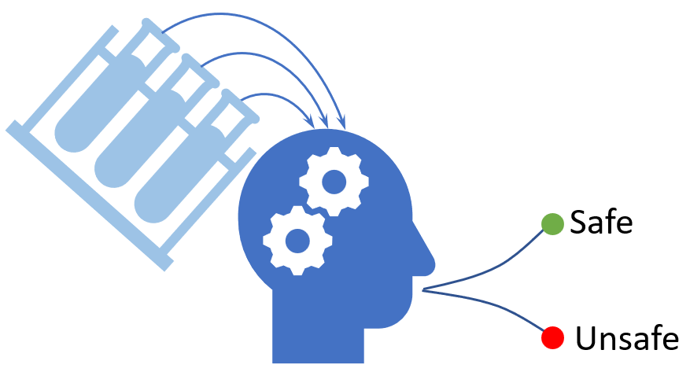
Business Question
How can businesses assure consumers of the safety and quality of their water-based products (e.g., beverages or food products) in regions with varying water potability standards?

Slide 5
Solution
Employ comprehensive testing protocols similar to the analytical models used here to continuously assess water quality in production. This mirrors the model's approach to detecting and addressing potability concerns.
Invest in cutting-edge technologies for real-time monitoring and data-driven decision-making. Like the machine learning models used, these systems can track and predict water quality changes, ensuring proactive measures to maintain safety.

Slide 6
Project Pipeline
Data Collection
Data Cleanup & Exploration
Data
Processing
Data Visualization
Data Analysis

Slide 7
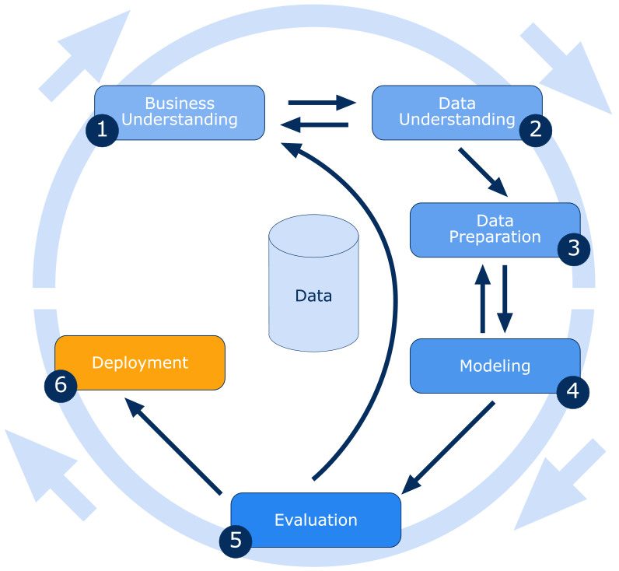
Methodology (CRISP-DM MODEL)

Slide 8
Data Understanding
Water parameters largely align with WHO safe drinking water standards, yet variations in quality may affect potability.
Parameters:
pH
Hardness
Total Dissolved Solids (TDS)
Chloramines
Sulfate
Conductivity
Organic carbon
Trihalomethanes
Turbidity

Slide 9
Data preparation and Visualization
Handled missing values (pH, Sulfate, Trihalomethanes) by using median imputation after identifying and visualizing missing data via a heatmap.
Calculated missing value percentages to ensure dataset completeness.
Explored the dataset through various visualizations, including histograms, scatterplots, and correlation matrices, to understand the relationships between variables.

Slide 10
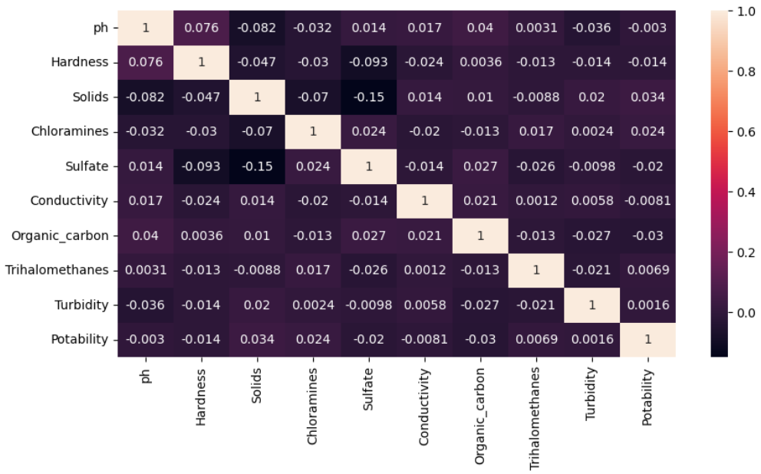
Heat Map

Slide 11


Modeling
Potability
Train Data
Model Classification
CSV Data
Test Data
Non-Potability
Data
Preparation

Slide 12
Evaluation
Confusion matrix values offer a detailed breakdown of true positives, false positives, true negatives, and false negatives, aiding comprehensive model evaluation.
Classification reports provide a holistic view by presenting scores like precision, recall, and F1-score, crucial for assessing model strengths and weaknesses.
This assessment facilitates pinpointing areas of enhancement, enabling focused improvements in the model's predictive capabilities.

Slide 13



Deployment
Deployed the application using Flask
It is a lightweight framework that offers hassle-free development.
Has flexibility and freedom to choose libraries and extensions.
Offers a built-in development server and fast debugger
Application Code
Deployed Application

Slide 14
Accuracy Table
Model | Accuracy
Logistic Regresion | 62.85%
K-Nearest neighbors | 63.49%
Support Vector Classifie | 68.85%
Naive Bayes | 63.68%
Decision tree | 58.96%
Random Forest | 68.21%

Slide 15





Technologies

Slide 16
Resources
https://www.kaggle.com/datasets/adityakadiwal/water-potability/data
https://www.linkedin.com/learning/data-science-foundations-fundamentals-14537508/data-preparation?u=2359714
https://www.linkedin.com/learning/hands-on-introduction-data-engineering/hands-on-data-engineering?u=2359714
https://www.coursera.org/learn/python-for-data-visualization

Slide 17
THANK YOU!

